Slide 1
OOPs in Python

Slide 2

Index
OOPs in Python
• Data Hiding and Decorators
• Data Hiding
• Decorators
• Decorators with parameters
• Chaining decorators

Slide 3
Data Hiding and Decorators
Data Hiding:
·An object attributes may or may not be visible outside the class definition.
· Attributes with double underscore(__) prefix are not visible or accessed directly to outsiders.
· Python protect these attributes by internally changing the name by including the class name.
Syntax:
· To access such attributes we have to use attribute name along with class name and object.
object._Classname__attributename

Slide 4
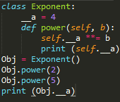
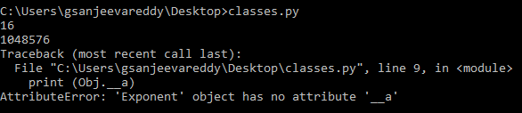
Data Hiding and Decorators
Example:
· Here in the example we gave a attribute with double underscores as __a.
· We used the exponent Class to calculate power of the value.
· We have object as Obj with which we access attribute and calculate power.
· Here when we try to access __a it will show an error as AttributeError that class has no attribute ‘__a’ . This is because it will not be visible outside the class.

Slide 5
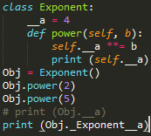

Data Hiding and Decorators
· To overcome this method python provide us with different syntax.
· For above example, Obj._Exponent__a is used to access __a attribute. This is because Python internally changes the attribute to include with class name.
Example:
· Now it won’t display any error and give the value associated with __a attribute.

Slide 6
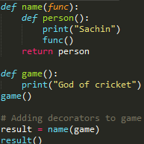

Data Hiding and Decorators
Decorators:
· Python has a interesting feature called decorators which will add functionality to the existing code.
· A part of a program is modified with the help of another program at compile time.
· Decorators are used in functions. It will take a function add functionality and return it.
· Decorators are denoted with the symbol @ with name of decorator function.
Example:
· In the example first we called game() normally and in second phase we
Added decorator(name) during the assignment step.
result= name(game)
· Then function game get decorated and return function was given the name result.

Slide 7
Data Hiding and Decorators
Decorators:
· We can decorator and reassign it to same function.
game = name(game)
· The most common way of using decorators is using @ symbol along with name of decorator function which should be placed above the definition of the function to be decorated.
Example:
@name
def game():
print(“God of cricket”)
· This is the normal way to implement decorators in python.

Slide 8
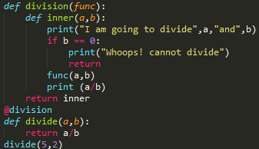

Data Hiding and Decorators
Decorators with Parameters:
· Decorators with parameters is different with normal decorators where we pass parameters to the function in this process.
Example:
· Above example let you know how to work on decorator arguments.
· The parameters that are in nested inner() function inside the decorators is same as the parameters of functions it decorates.
· We can use function(*args, **kwargs) where args are tuple of positional arguments and kwargs are dictionary of keyword arguments.

Slide 9
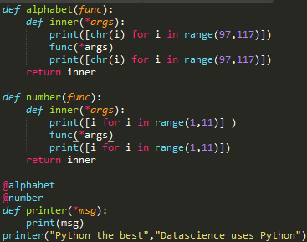
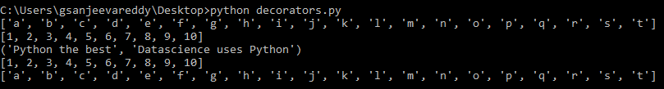
Data Hiding and Decorators
Chaining Decorators:
· A function can be decorated multiple times with different decorators.
· This can be done by placing the decorators above the required function.
Example:

